Slide 1
Team Members 1. Dawit Anbessie ………………….610521 2. Henok Damtew ………………...985772 3. Gizaw Dulecha ………………..108882 4. Zelalem Gelgelo ………………109695
SOFTWARE Engineering Project

Slide 2
Contents
Introduction
Use case diagram
System architecture diagram
Key abstraction list
VOPC diagram
Use case description
Sequence diagram

Slide 3
Introduction
Currently airlines industry has evolved into one of the most sophisticated and fascinating industries. Today, millions of people fly every day. So, this sophisticated industry need online ticket purchase system is one of the major contributors in the increase of the passengers using air travel.
Our project is on E flight booking system.
The user can view available flight and book a flight etc..
The Admin can add flight, remove flight etc.

Slide 4
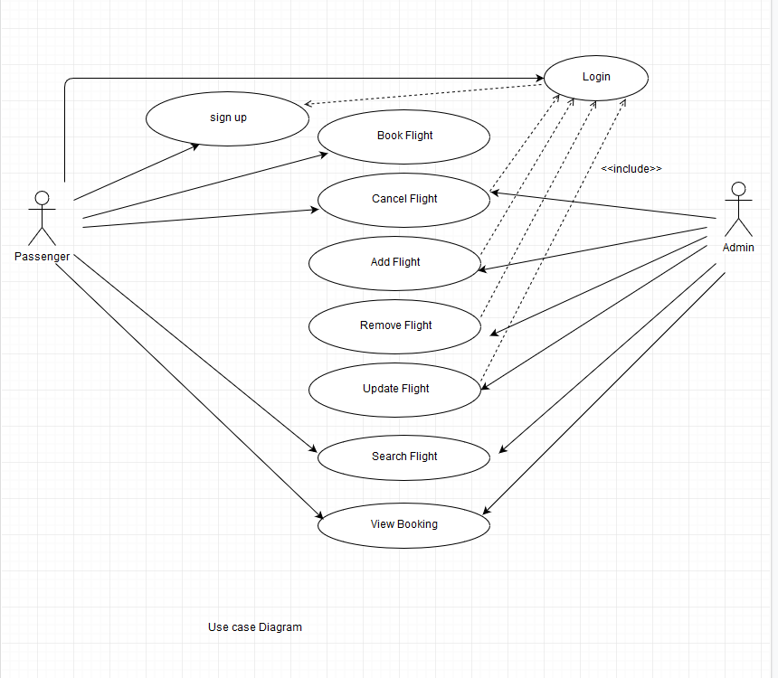
2.Use case diagram

Slide 5
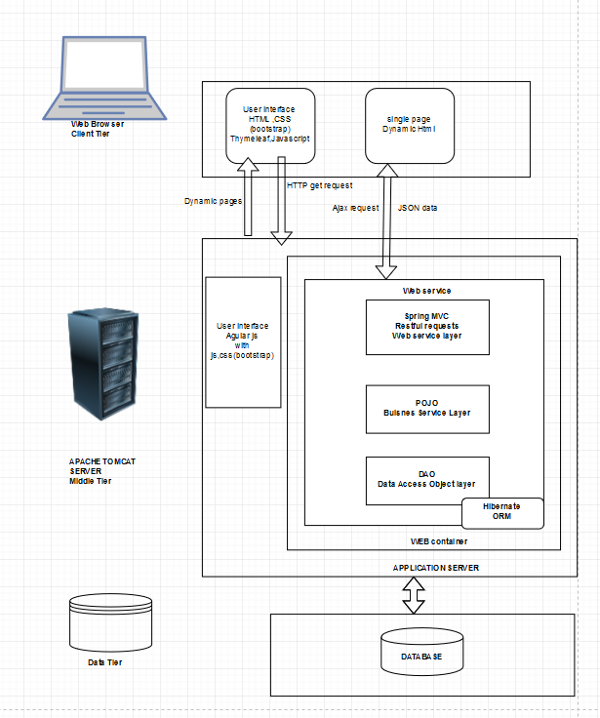
3.System architecture diagram

Slide 6
4.Key Abstractions
Passenger
Airline
Airplane
Booking
Airport
Flight
Admin

Slide 7
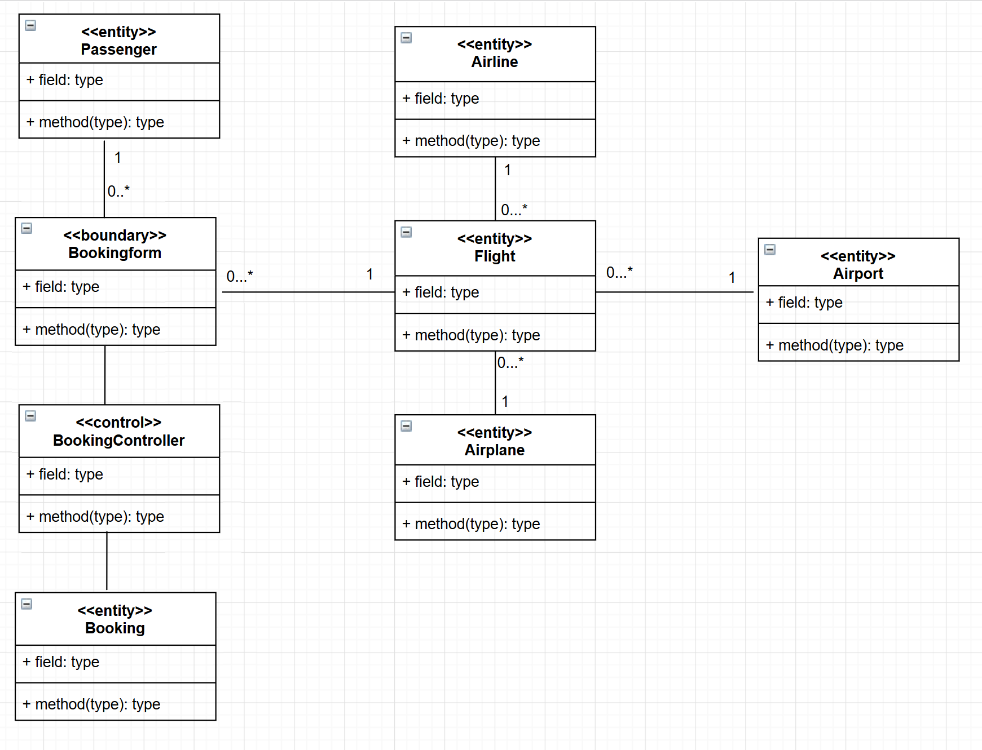
5.VOPC Diagram

Slide 8
6.Use case description

Slide 9
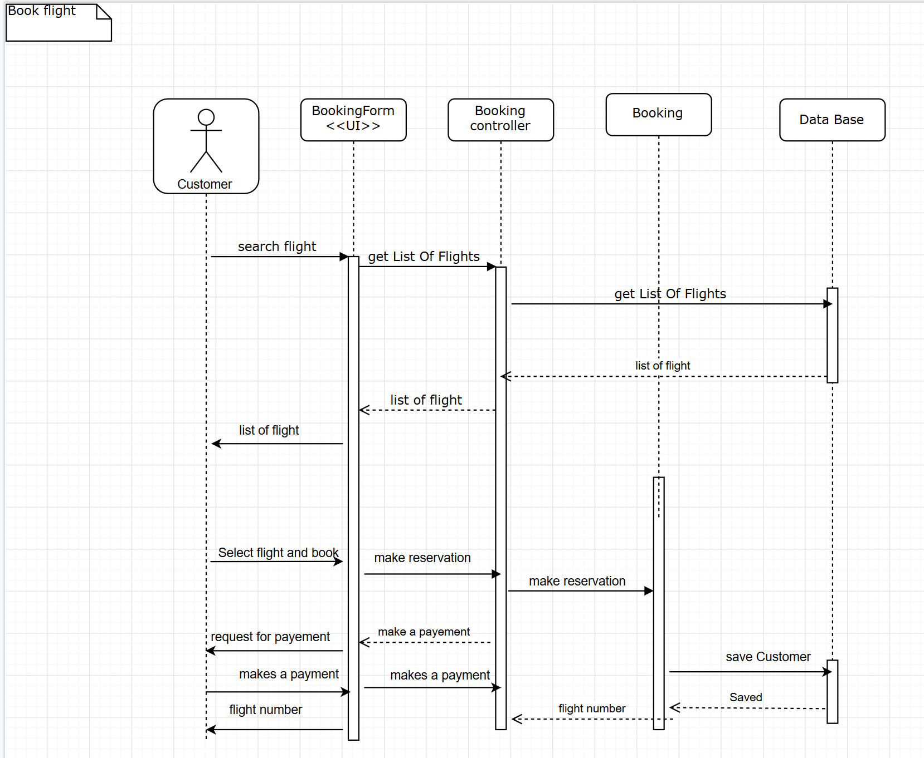
7.Sequence Diagram

Slide 10
Thank you!

